Slide 1
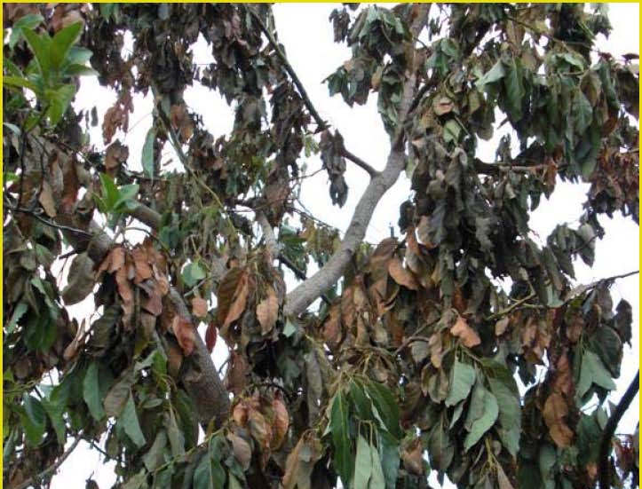
Socio-economic importance of the RAB & Laurel Wilt Disease
Dr. Edward ‘Gilly’ Evans
Assistant Professor and Associate Director
University of Florida, Center for Tropical Agriculture

Slide 2
Potential Economic Impact of the Laurel Wilt Disease on the Industry
Estimate the direct losses:
  Discussions with industry experts, growers, extension agents
  Use internet tools such as tree value analysis tool available at http://agecon-trec.ifas.ufl.edu/TreeCostAvocado.htm
Estimate the indirect or ‘spillover’ losses (local impacts)
  Much more challenging; requires the use of an input-output model
  Use economic model known as IMPLAN input-output multipliers
Focus on 3 scenarios:
Notes:
2

Slide 3
Estimates of Direct Cost ($)
Item | Do Nothing | 75% Reduction in Production | 50% Reduction in Production
Industry Sales Loss | $30,000,000 | $22,500,000 | $15,000,000
Decline in Property Value | $326,250,000 | $244,688,000 | $163,125,000
Increased Management Costs | ― | $3,510,000 | $3,510,000
Total | $356,250,000 | $270,698,000 | $181,650,000

Slide 4

Estimating the Economic Impact on Local/Regional Economy
Input-Output model
Interdependencies among industries and the associated primary factor of production
Fertilizers
Fertilizers
$$$ labor income
$$$ labor income
Avocado Industry
Packing materials
Packing materials
$$$ Gov. Tax
$$$ Gov. Tax
Chemicals
Chemicals
Output
Inputs for other industries
Output
Inputs for other industries

Slide 5
Economic Impact of Laurel Wilt on the Local
Economy
Item | Base Case | 75% Reduction in Production | 50% Reduction in Production
Industry Sales | $30,000,000
Total Economic Impact (output)
Employment Impacts (FTE)
Labor Income Impacts
Indirect Business Tax

Slide 6
Economic Impact of Laurel Wilt on the Local
Economy
Item | Base Case | 75% Reduction in Production | 50% Reduction in Production
Industry Sales | $30,000,000
Total Economic Impact (output) | $54,266,259
Employment Impacts (FTE) | 546
Labor Income Impacts | $19,674,272
Indirect Business Tax | $1,862,415

Slide 7
Economic Impact of Laurel Wilt on the Local
Economy
Item | Base Case | 75% Reduction in Production | 50% Reduction in Production
Industry Sales | $30,000,000 | $7,500,00
Total Economic Impact (output) | $54,266,259
Employment Impacts (FTE) | 546
Labor Income Impacts | $19,674,272
Indirect Business Tax | $1,862,415

Slide 8
Economic Impact of Laurel Wilt on the Local
Economy
Item | Base Case | 75% Reduction in Production | 50% Reduction in Production
Industry Sales | $30,000,000 | $7,500,00
Total Economic Impact (output) | $54,266,259 | $13,566,565
Employment Impacts (FTE) | 546 | 136
Labor Income Impacts | $19,674,272 | $4,918,568
Indirect Business Tax | $1,862,415 | $465,605

Slide 9
Economic Impact of Laurel Wilt on the Local
Economy
Item | Base Case | 75% Reduction in Production | 50% Reduction in Production
Industry Sales | $30,000,000 | $7,500,00 | $15,000,000
Total Economic Impact (output) | $54,266,259 | $13,566,565 | $27,133,130
Employment Impacts (FTE) | 546 | 136 | 273
Labor Income Impacts | $19,674,272 | $4,918,568 | $9,837,136
Indirect Business Tax | $1,862,415 | $465,604 | $931,208

Slide 10
Economic Impact of Laurel Wilt on the Local
Economy
Item | Base Case | 75% Reduction in Production | 50% Reduction in Production
Industry Sales | $30,000,000 | $7,500,00 | $15,000,000
Total Economic Impact (output) | $54,266,259 | $13,566,565 | $27,133,130
Employment Impacts (FTE) | 546 | 136 | 273
Labor Income Impacts | $19,674,272 | $4,918,568 | $9,837,136
Indirect Business Tax | $1,862,415 | $465,604 | $931,208

Slide 11
Further Implications of Disease Complex

Slide 12
Table 1: Replacement cost based on value of avocado trees*
 | Unit | Miami-Dade | Broward | Palm Beach | Lee | TOTAL
No. of commercial trees | No. | 643,800 | 870 | 2,610 | 7,830 | 655,110
No. of backyard trees | No. | 250,000 | 182,554 | 131,898 | 61,830 | 626,282
TOTAL TREES | No. | 893,800 | 183,424 | 134,508 | 69,660 | 1,281,392
Replacement Cost (commercial) | $ | 212,454,000 | 287,100 | 861,300 | 2,583,900 | 216,186,300
Replacement Cost (backyard) | $ | 82,500,000 | 60,242,721 | 43,526,275 | 20,403,970 | 206,672,967
TOTAL COST | $ | 294,954,000 | 60,529,821 | 44,387,575 | 22,987,870 | 422,859,267

Slide 13
Table 1: Replacement cost based on value of avocado trees*
 | Unit | Miami-Dade | Broward | Palm Beach | Lee | TOTAL
No. of commercial trees | No. | 643,800 | 870 | 2,610 | 7,830 | 655,110
No. of backyard trees | No. | 250,000 | 182,554 | 131,898 | 61,830 | 626,282
TOTAL TREES | No. | 893,800 | 183,424 | 134,508 | 69,660 | 1,281,392
Replacement Cost (commercial) | $ | 212,454,000 | 287,100 | 861,300 | 2,583,900 | 216,186,300
Replacement Cost (backyard) | $ | 82,500,000 | 60,242,721 | 43,526,275 | 20,403,970 | 206,672,967
TOTAL COST | $ | 294,954,000 | 60,529,821 | 44,387,575 | 22,987,870 | 422,859,267

Slide 14
Wider Implications of Disease Complex

Slide 15
2008

Slide 16


Slide 17


Slide 18
Concluding Remarks
Together, the ambrosia beetle and laurel wilt disease represent a serious threat to the Florida avocado industry.
Currently, the industry generates an economic impact of over $54 million dollars, contributes to agricultural labor employment, and is a source of $1.9 million annually in government revenue.
Longer term the disease complex represents a threat to California avocado industry as well as avocado production in Latin America and Caribbean countries.

Slide 19
Thanks

